Slide 1
UNESCO in Małopolska
Authors: Patrycja Włodarczyk and Miłosz Lech

Slide 2
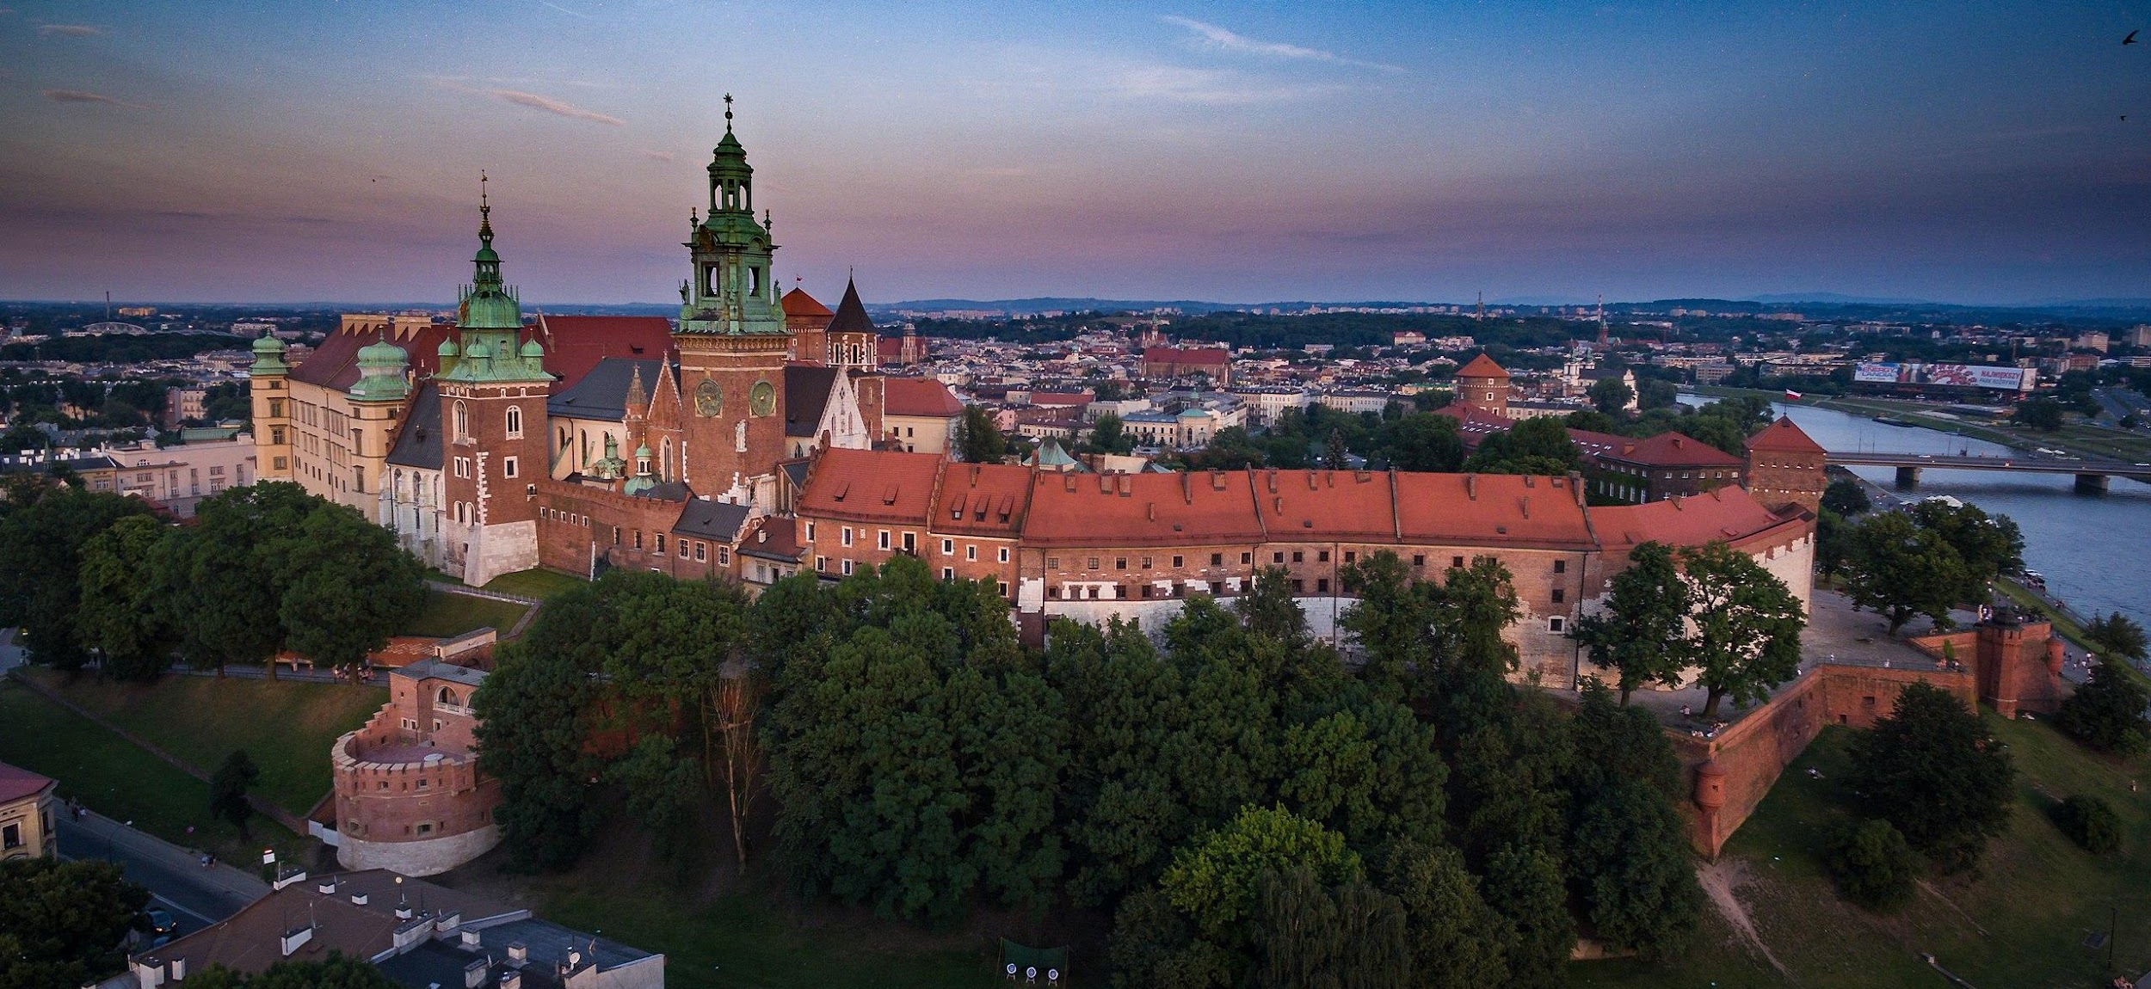
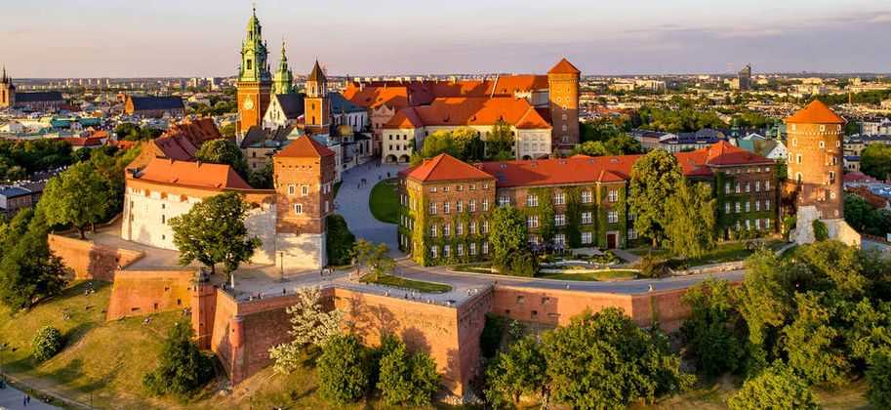
Something about UNSCO in our region
UNESCO world heritage list was established in 1972. In Poland there are 28 assets and 14 of them in Małopolska. The most prominent of them are :
Old town in Cracow
Wawel
salt mine in Bochnia
salt mine in Wieliczka
Auschwitz Birkenau
Jewish Calvary
Wooden churches

Slide 3
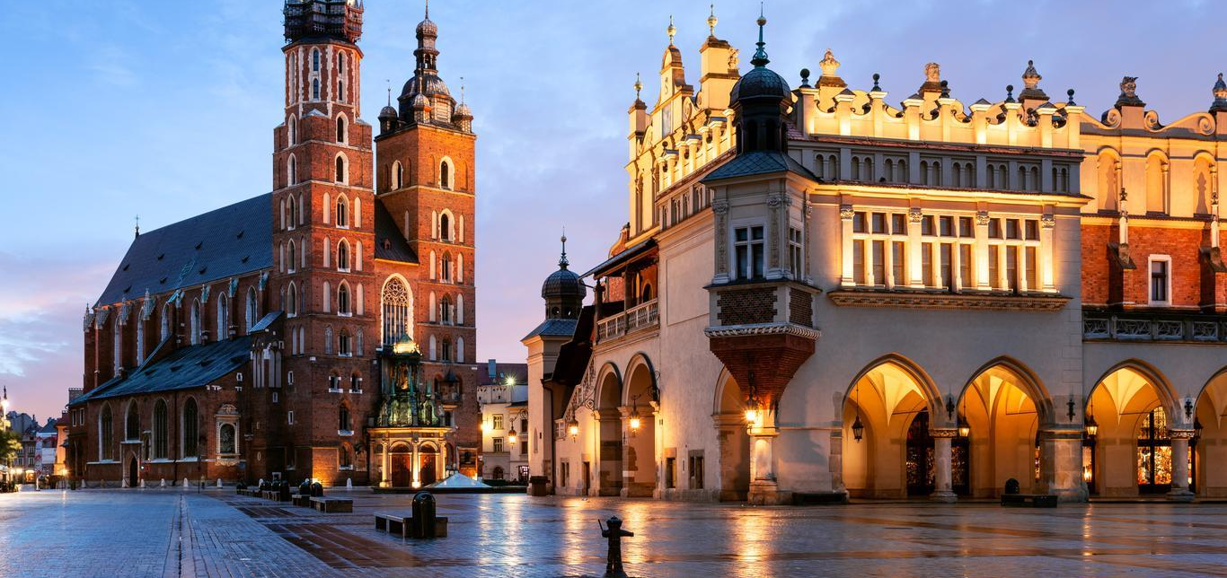
Old town in Cracow
Cracow - One of the largest cities of Małopolska, its current capital and the former capital of Poland. For centuries, it was the seat of kings. Buildings located within the Old town are Planty, Barbican, Sukiennice, St. Mary’s church, clock tower, Floriańska Gate.

Slide 4
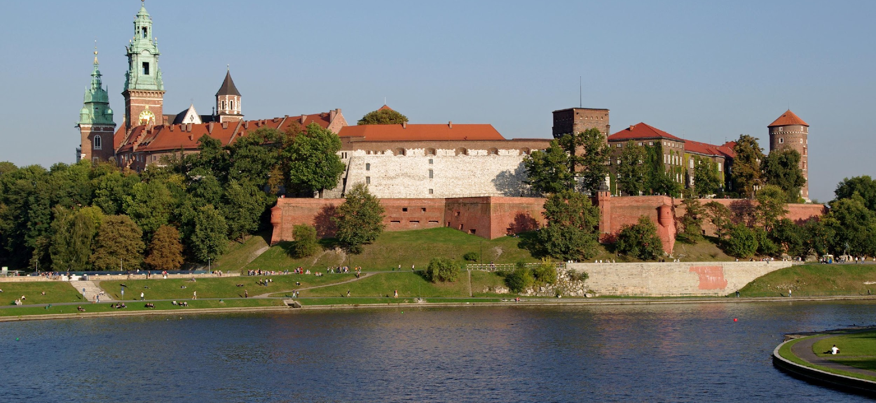
Wawel
Here the kings of Poland were crowned and not only. There are 18 chapels. The most interesting is the Sigismund Chapel in which there is the largest bell which tolls only on special occasions. It is worth visiting the dragon's den- the cave in the castle hill where, according to the legends, the dragon living in the area ate a stuffed ram.

Slide 5
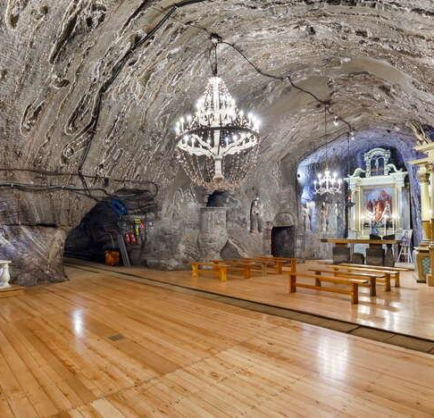
Salt mine in Bochnia
It is the oldest and most beautiful salt mine in Poland. On the tourist route, we have an underground multimedia exhibition- an interesting attraction. Is an underground cruise through the flooded corners of the mine. In the chapel of St. Kinga masses are celebrated regularly and there are active tracks running through it.

Slide 6
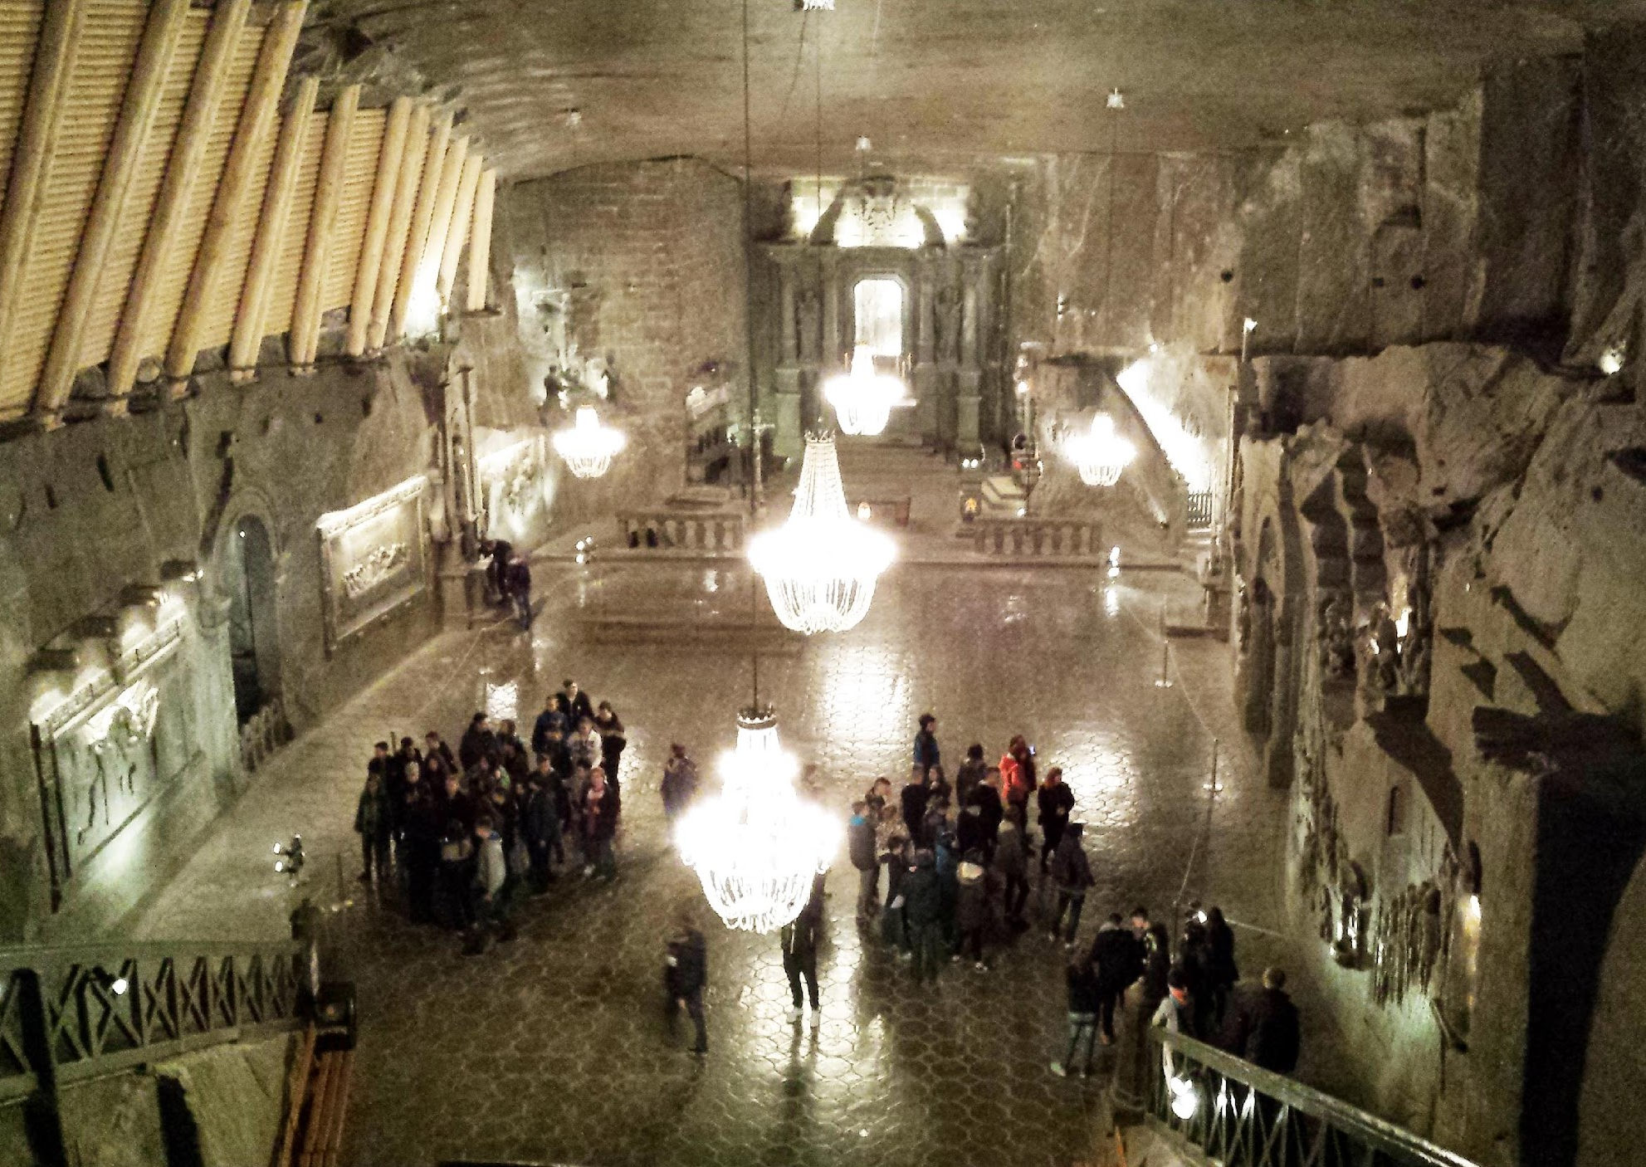
Salt mine in Wieliczka
Salt has been mined here since the 12th century (listed in 1978). There is a 2 km long tourist route. It is the only active mining facility since the 13th century. The whole mine is one big museum .

Slide 7
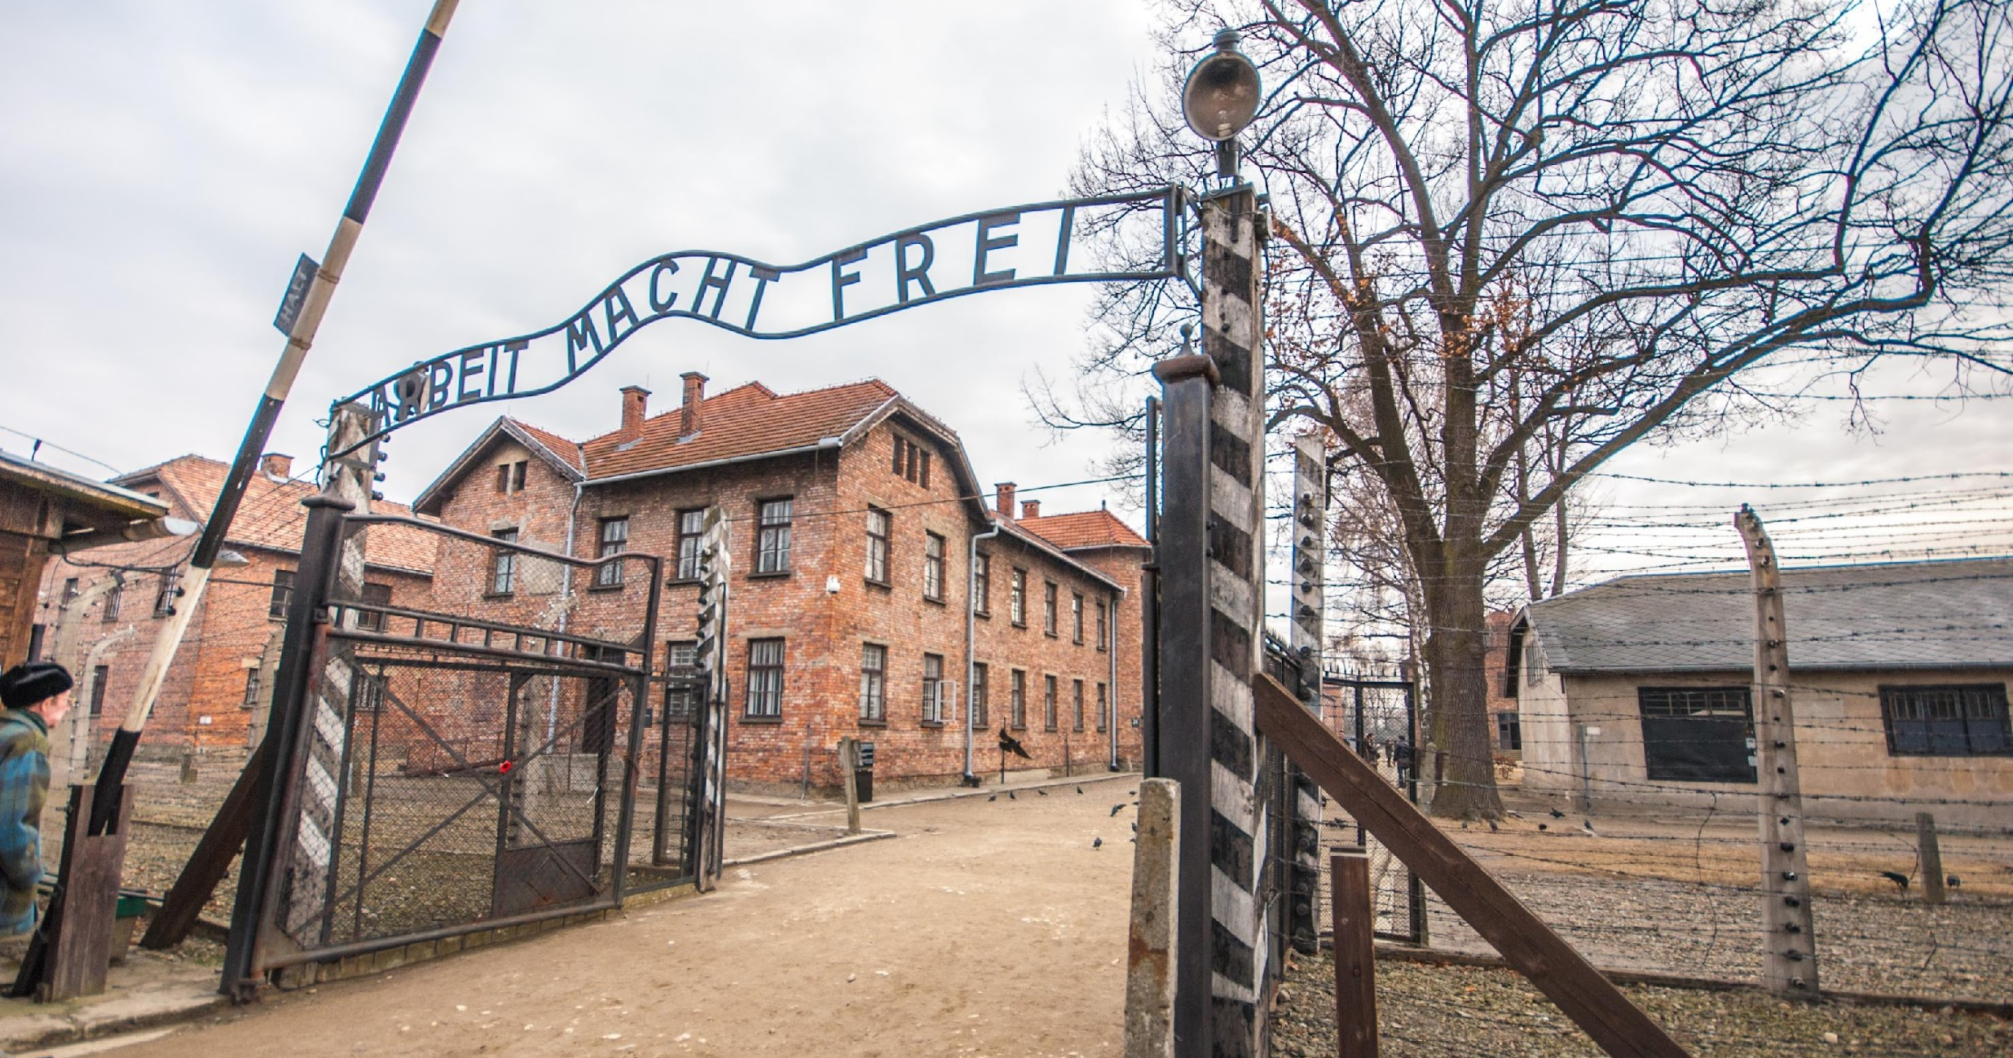
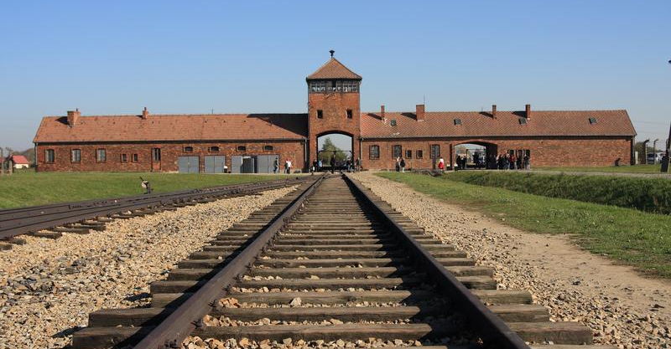
Auschwitz
Auschwitz camp was established by the Germans for Polish and Jewish prisoners during World War 2 on the territory of occupied Oświęcim. It is one of the biggest extermination sites of European Jews. On it’s territory there is a museum.

Slide 8
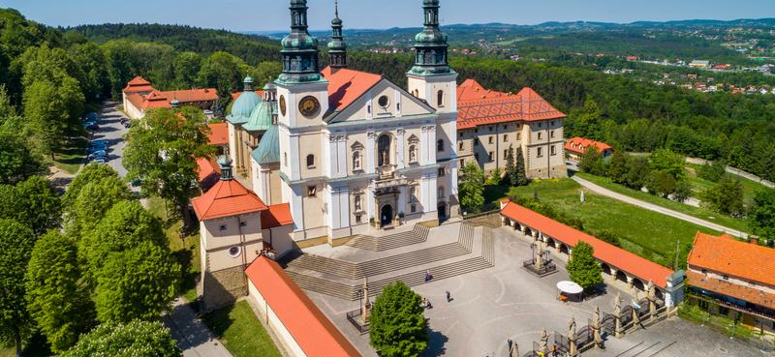
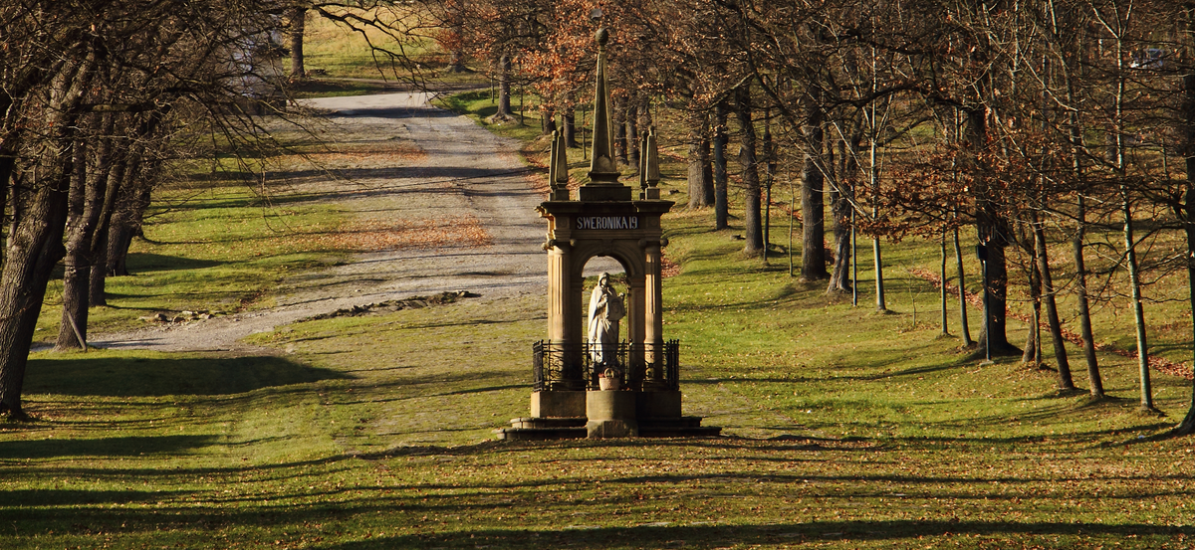
Calvary
It’s the second-largest place of pilgrimage in Poland.There is a sanctuary there and the Calvary, or Stations of the Cross. During Holy Week, the mystery of the Lord's Passion takes place there as well as a holy staircase behind the mountainside with relics of the holy land.

Slide 9
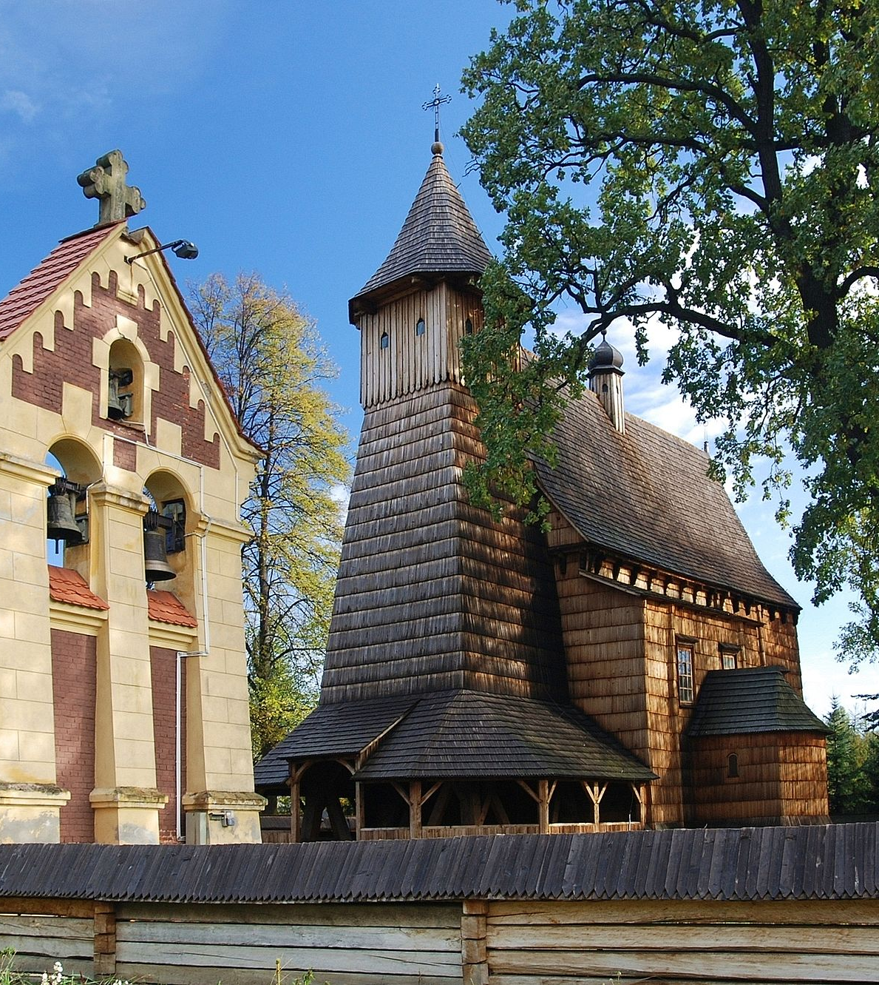
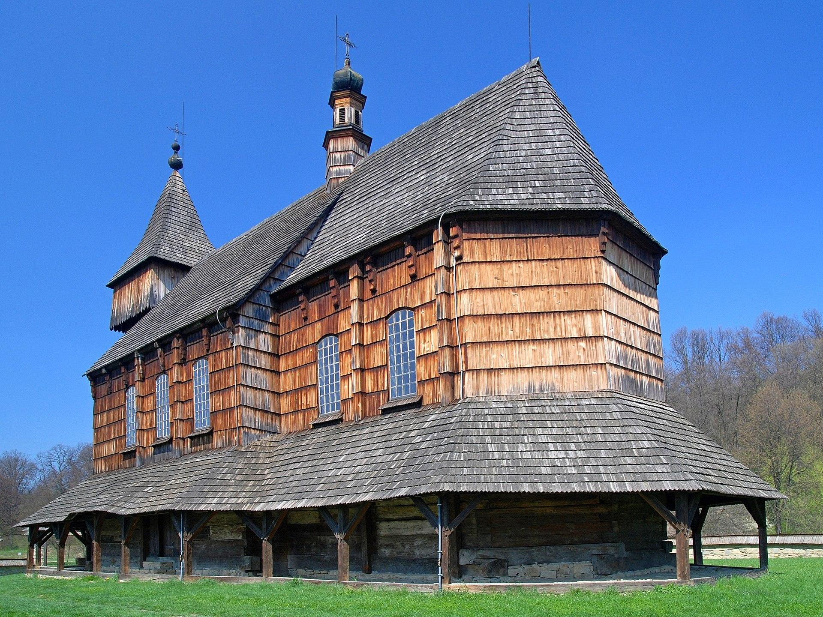
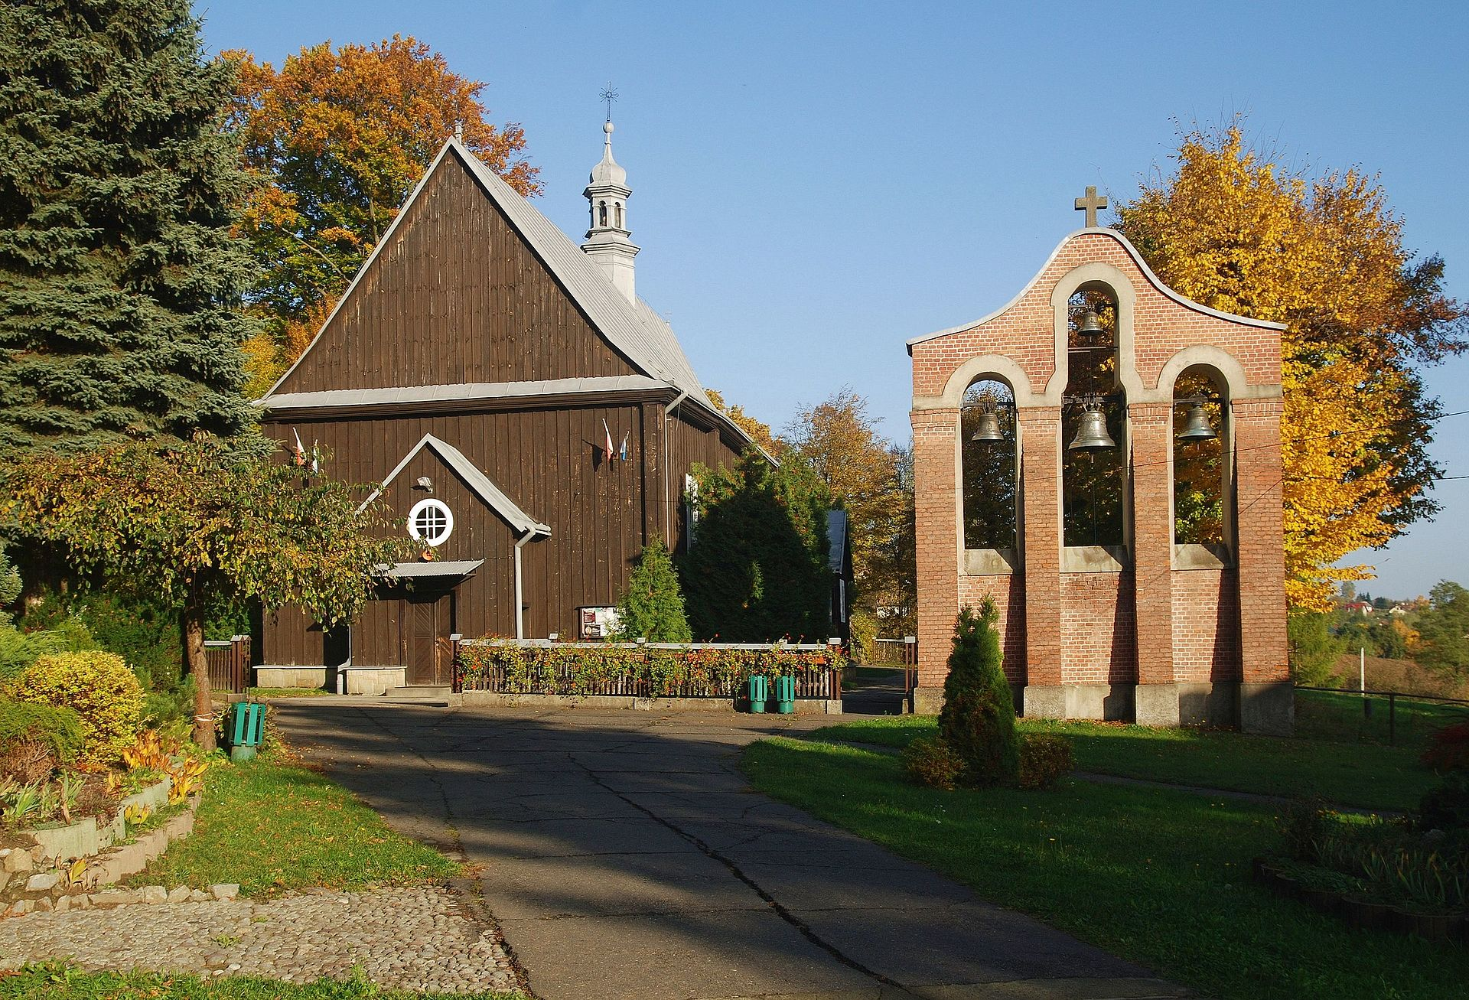
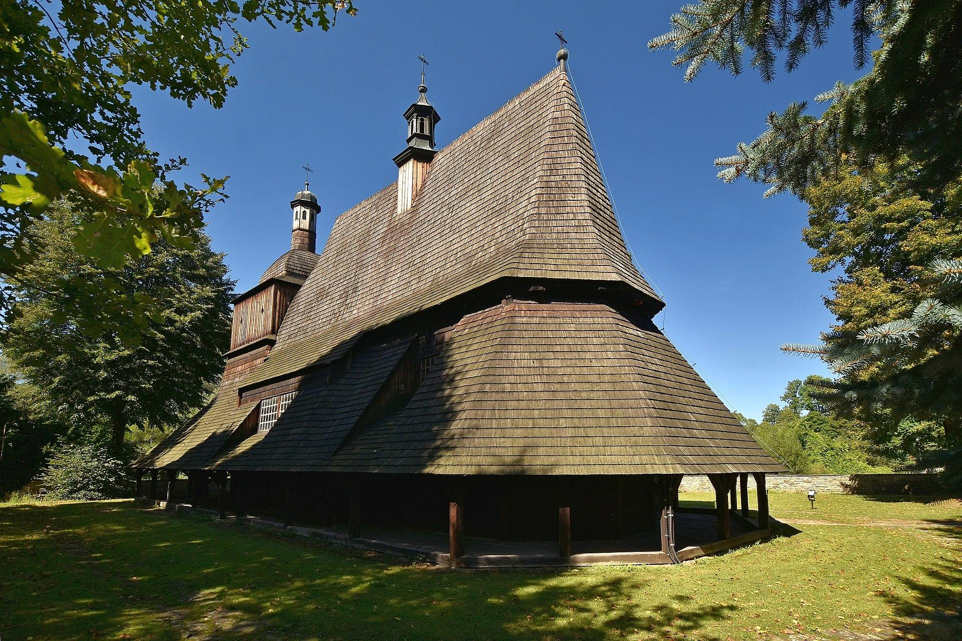
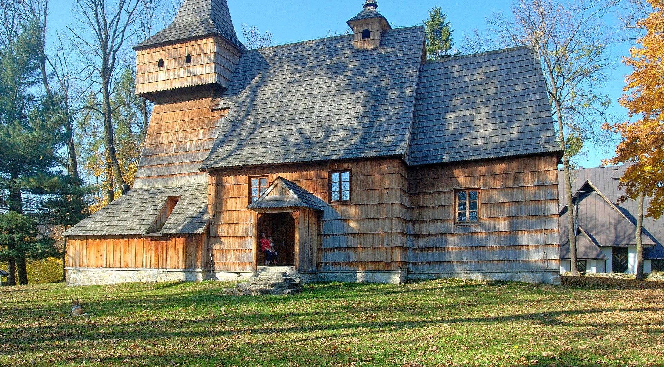
Wooden churches
There are a lot of woodn churches in Malopolska that are listed in UNESSCO, for example:
Church of St. Michael the Archangel in Binarowa,
Church of All Saints in Blznem,
Church of St. Michael the Archangel in Dębno Podhalański,
Church of the Assumption of the Blessed Virgin Mary in Haczów,
Church of St. Leonard in Lipnica Murowana,
Church of St. Philip and St. James in Sękowa.

Slide 10
Sources
Małopolska.pl
pictures
Wikipedia.org
Gethome.pl
Polska.travel
Gov.pl
VisitMalopolska.pl

